Slide 1

PREDICTION

Slide 2

Overview:
Welcome to the presentation on Loan Repayment Prediction, where we explore the application of machine learning techniques to forecast the likelihood of borrowers repaying their loans on time. In today's financial landscape, accurate prediction of loan repayment is paramount for lending institutions to manage risks effectively and ensure sustainable operations.

Slide 3
Objective:
Throughout this presentation, we will delve into the methodology, findings, and implications of our loan repayment prediction model. We'll provide insights into the dataset used, the machine learning algorithms employed, key performance metrics, and the practical applications of predictive modeling in lending practices. Our aim is to showcase the significance of predictive analytics in facilitating more efficient and equitable lending processes.

Slide 4
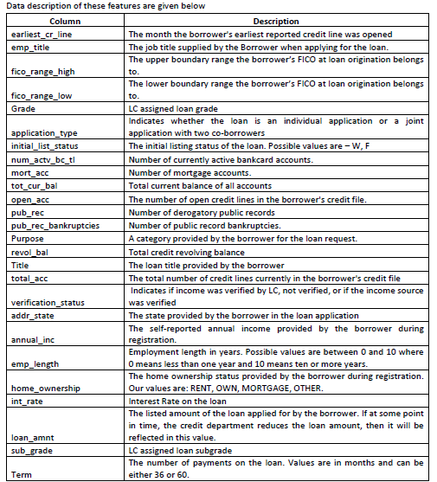
Dataset Description:
The analysis in this presentation is based on a comprehensive loan records dataset, encompassing various attributes related to borrowers and their loan profiles. The dataset includes features such as loan amount, loan term, interest rate, employment status, FICO credit score, and other relevant financial indicators.

Slide 5

Dataset Description:
The analysis in this presentation is based on a comprehensive loan records dataset, encompassing various attributes related to borrowers and their loan profiles. The dataset includes features such as loan amount, loan term, interest rate, employment status, FICO credit score, and other relevant financial indicators.

Slide 6
Preprocessing Steps: Prior to model development, the dataset underwent rigorous preprocessing to ensure data quality and model robustness. This preprocessing involved steps such as:
Data Cleaning: Handling missing values, outliers, and inconsistencies in the dataset to ensure data integrity.
1
Feature Scaling: Standardizing or normalizing numerical features to a common scale to prevent dominance by certain variables.
2
Feature Engineering: Creating new features or transforming existing ones to enhance the predictive power of the model.
3
Data Splitting: Partitioning the dataset into training and testing sets to evaluate the model's performance effectively.
4

Slide 7
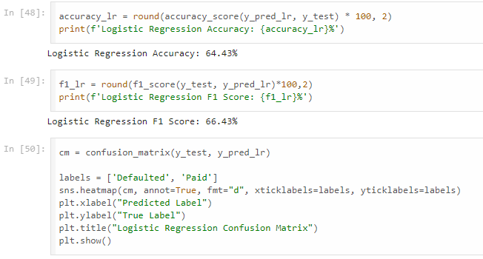
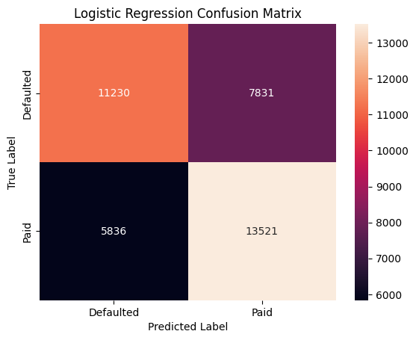
Models:
LOGISTIC REGRESSION
- Logistic regression is a process of modeling the probability of a discrete outcome given an input variable. The most common logistic regression models a binary outcome; something that can take two values such as true/false, yes/no, and so on.

Slide 8
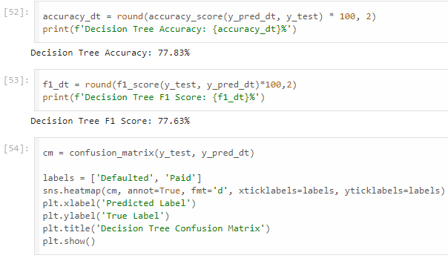
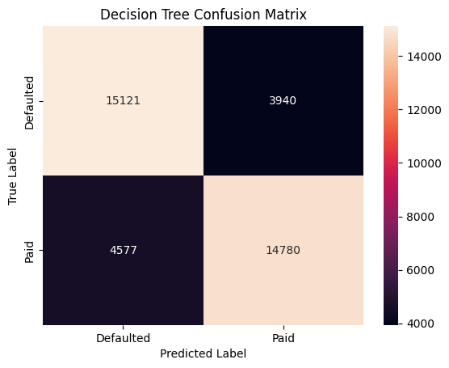
Models:
DECISION TREE
- A decision tree is a decision support hierarchical model that uses a tree-like model of decisions and their possible consequences, including chance event outcomes, resource costs, and utility. It is one way to display an algorithm that only contains conditional control statements.

Slide 9
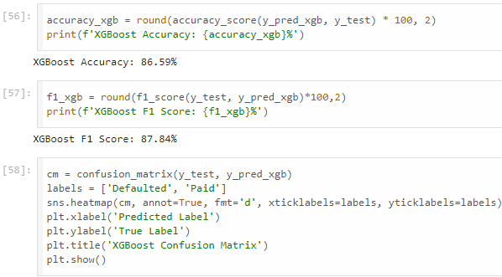
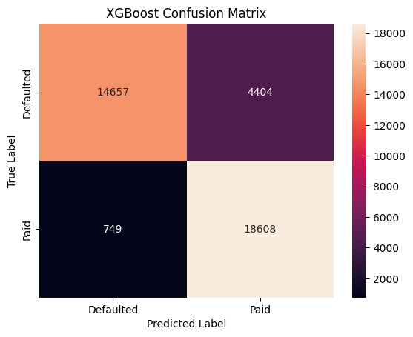
Models:
XGBOOST
- XGBoost, which stands for Extreme Gradient Boosting, is a scalable, distributed gradient-boosted decision tree (GBDT) machine learning library. It provides parallel tree boosting and is the leading machine learning library for regression, classification, and ranking problems.

Slide 10
Models:
ADABOOST
- Adaboost is an ensemble learning technique used to improve the predictive accuracy of any given model by combining multiple “weak” learners. Adaboost works by weighting incorrectly classified instances more heavily so that the subsequent weak learners focus more on the difficult cases.

Slide 11
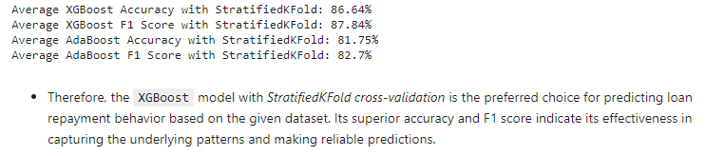
Hyperparameter Tuning:
Overall, XGBoost and AdaBoost has emerged as the most suitable models for predicting loan repayment behavior based on the given dataset.
Further we applied hyperparameter tuning using StratifiedKFold.
Stratified kfold cross validation is an extension of regular kfold cross validation but specifically for classification problems where rather than the splits being completely random, the ratio between the target classes is the same in each fold as it is in the full dataset.

Slide 12
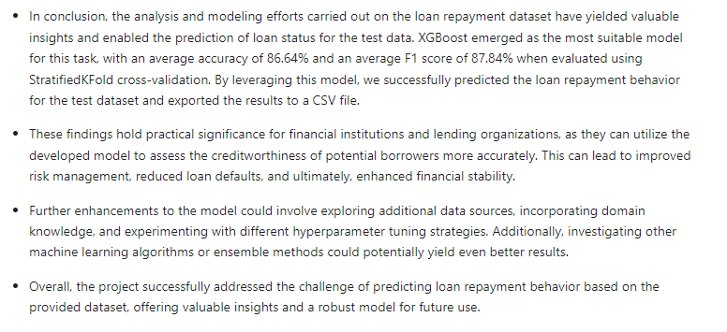
Conclusion:

